Slide 1
Citizenship:
Hand Signals
Thanks
Zach!
A Mnemonic Device to Remember the Bill of Rights

Slide 2


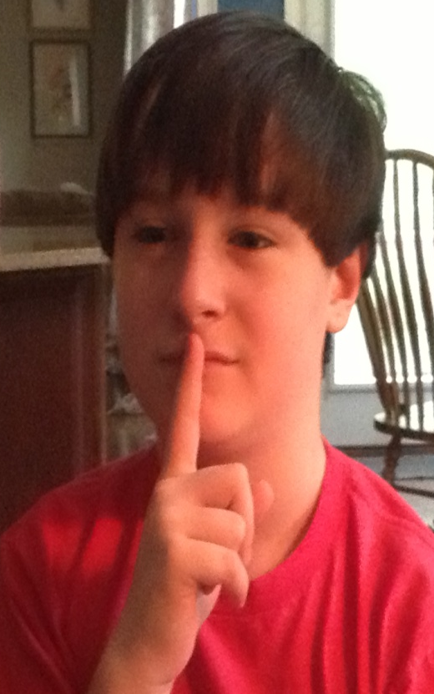
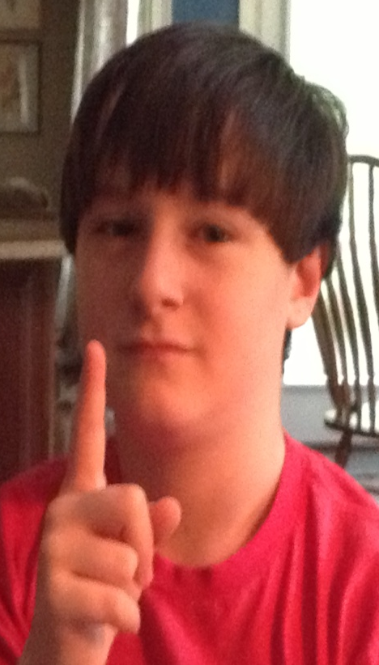
First Amendment: Use your index finger
Freedom of Speech

Slide 3
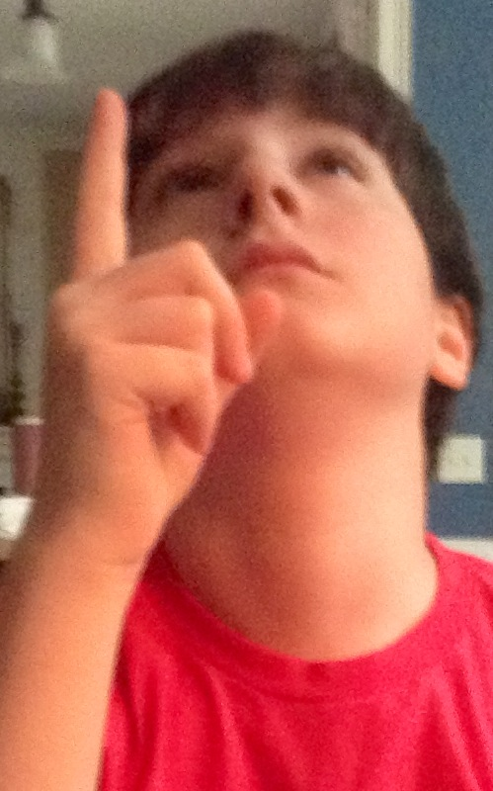
First Amendment:
Use your index finger and look up!
Freedom of Religion
This means you have a right to believe in what you want to!

Slide 4
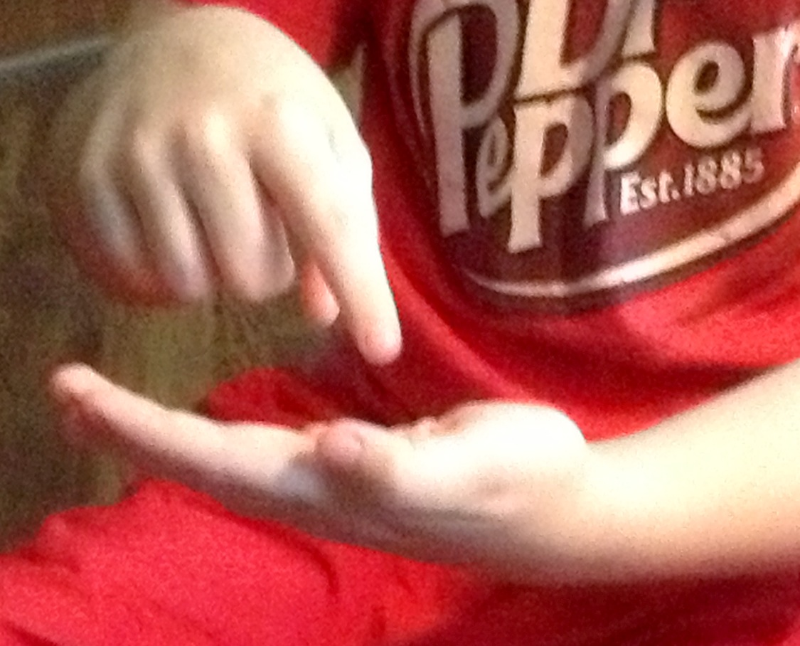
First Amendment: Use your index finger and other hand.
Freedom of Press
You can write what you think as long as it isn’t a lie!

Slide 5
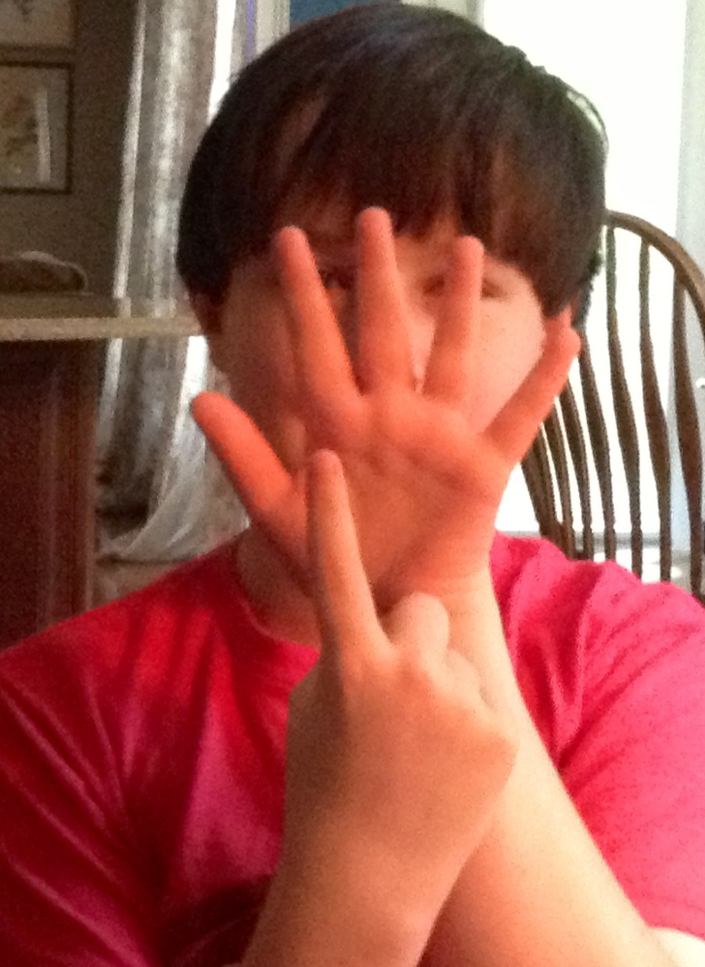
First Amendment: Use your index finger and other hand.
Freedom of Assembly
You have a right to meet in a group!

Slide 6
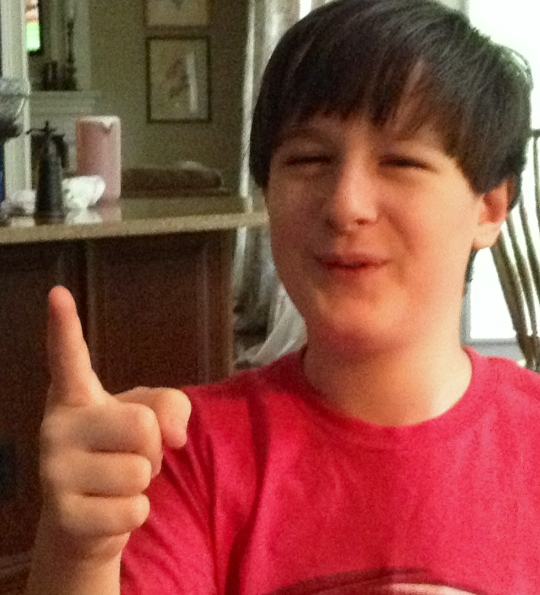
First Amendment: Use your index finger and other hand.
Freedom to Petition
Doesn’t look like he has a grievance but he tried!

Slide 7
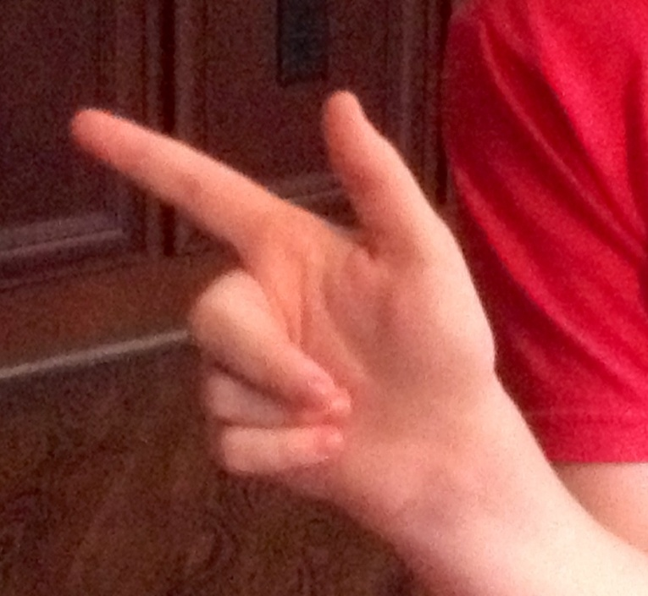
Second Amendment: Use your index finger and other hand. Say… “the right to bear arms”
Right to Bear Arms
Remember to do this appropriately! We are in school

Slide 8
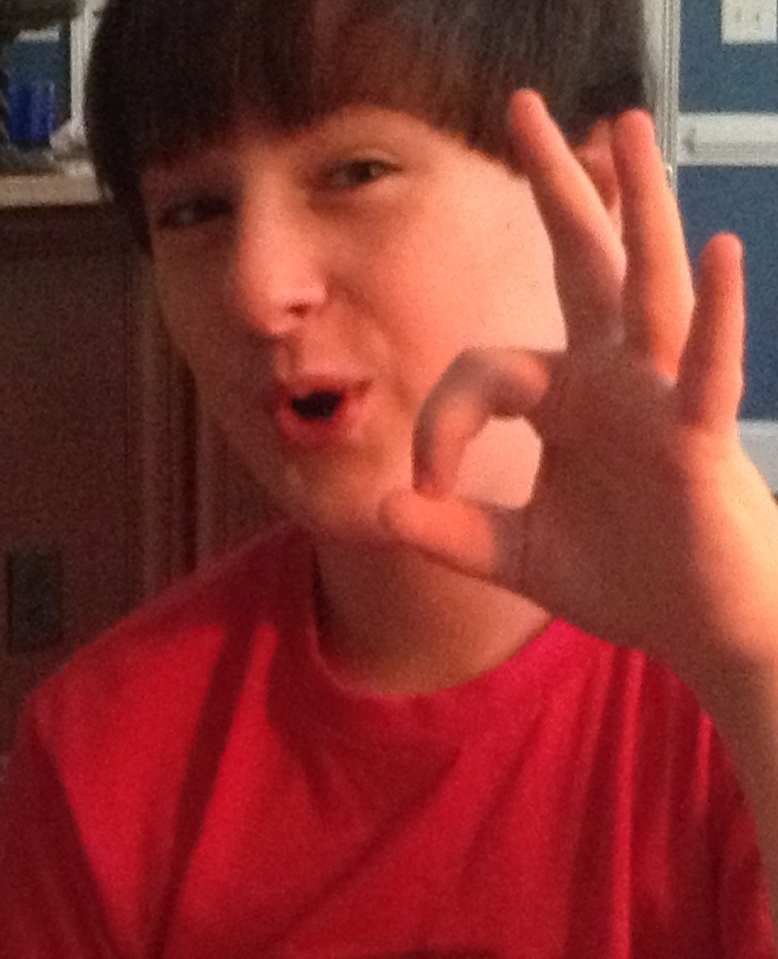
Third Amendment: Use your index finger and other hand. (Two Fingers)
No quartering of soldiers in your home
Say no to quartering soldiers

Slide 9
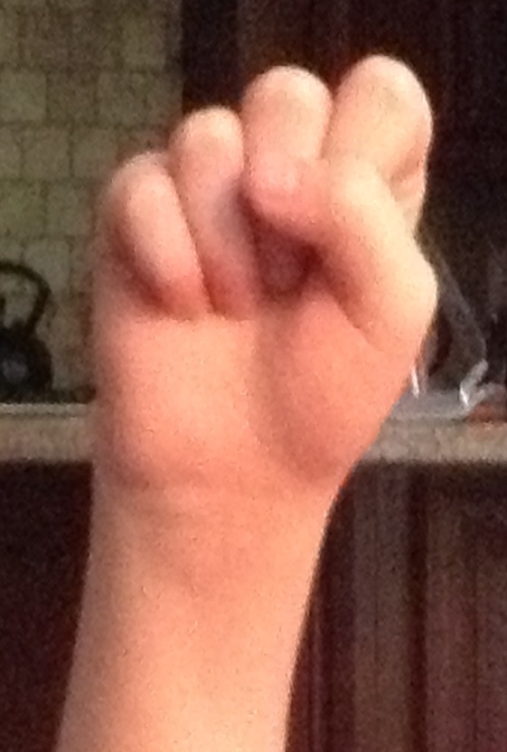
Fourth Amendment: Make a fist and pretend to knock on a door
Say: NO illegal searches and seizures!
No searching or seizing without a warrant and probable cause!

Slide 10
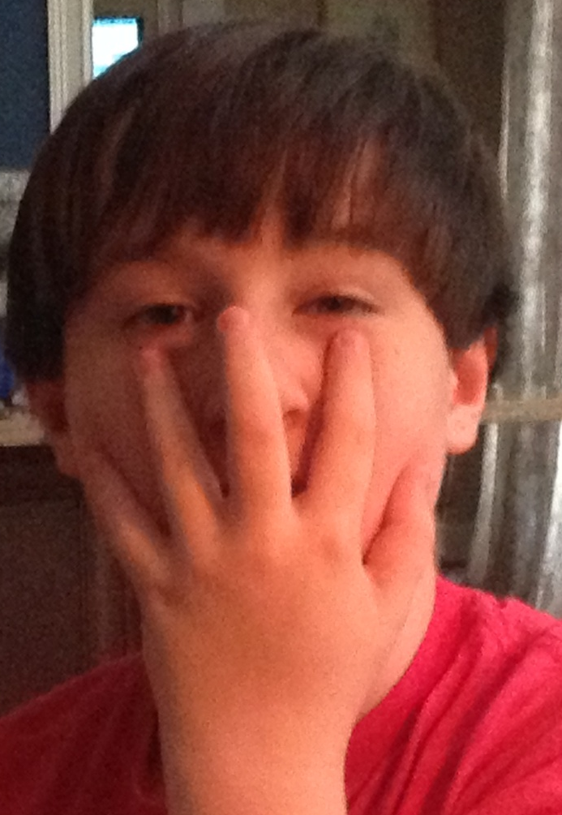
Fifth Amendment: Open your hand and cover your mouth!
Say: You have a right to remain silent!
You have a right to due process, a trial, and an attorney!

